Slide 1
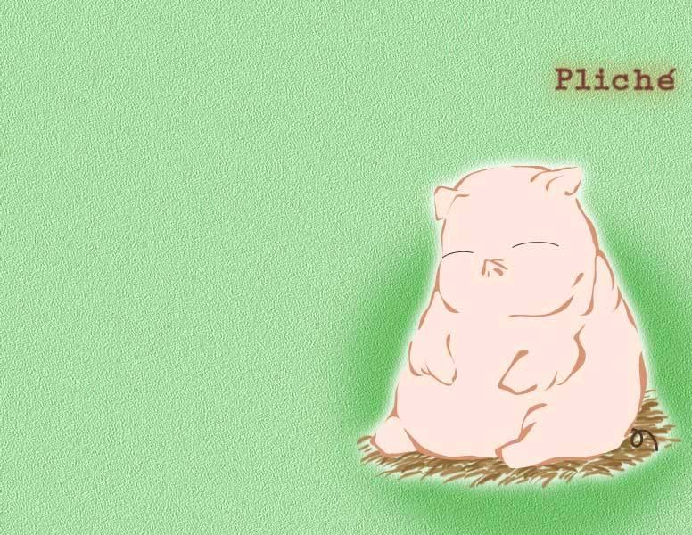
外研版三年级英语上册
Unit 1
This is his head

Slide 2
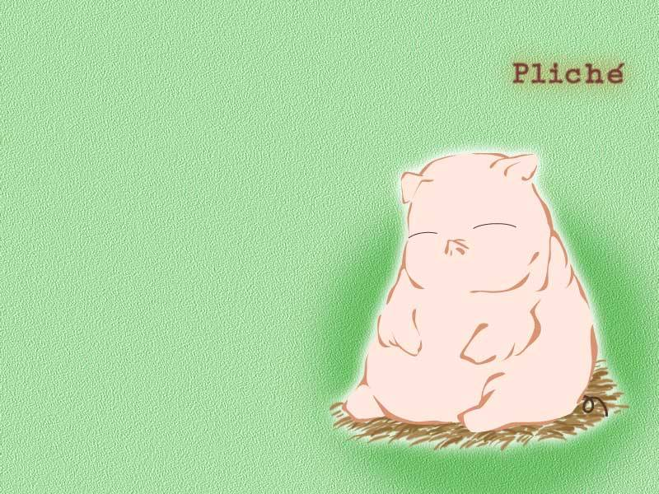
Chant
This is mother
panda and father panda,
too.Grandma,grandpa,
brother,sister
all in the zoo.

Slide 3
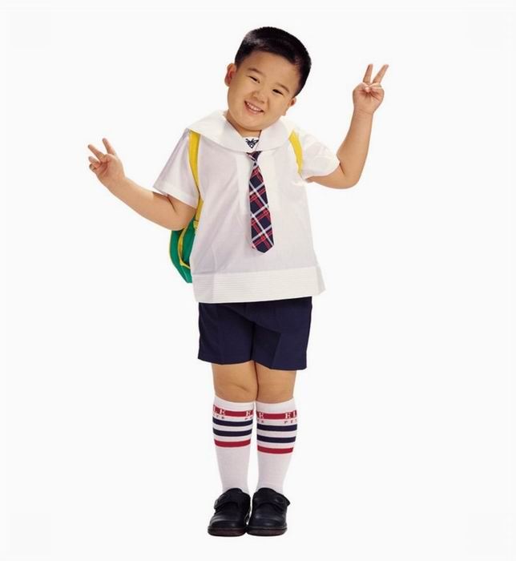
His name is Xiaoming.

Slide 4





——head

Slide 5
arm——

Slide 6
——hand

Slide 7

leg——

Slide 8
——foot

Slide 9
——head
——hand
arm——
——leg
——foot

Slide 10
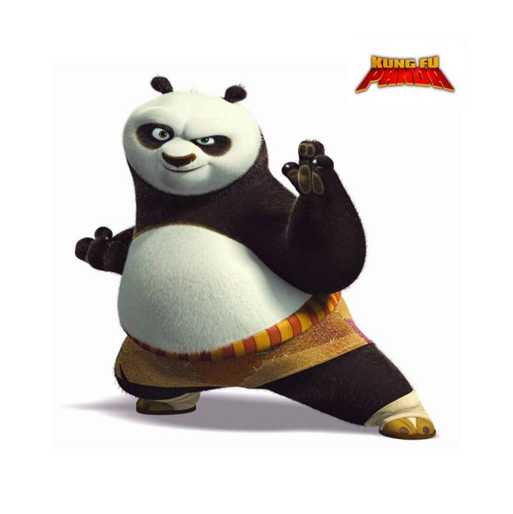
Hello!I'm Panpan.
PPT模板：www.1ppt.com/moban/ PPT素材：www.1ppt.com/sucai/
PPT背景：www.1ppt.com/beijing/ PPT图表：www.1ppt.com/tubiao/
PPT下载：www.1ppt.com/xiazai/ PPT教程： www.1ppt.com/powerpoint/
资料下载：www.1ppt.com/ziliao/ 范文下载：www.1ppt.com/fanwen/
试卷下载：www.1ppt.com/shiti/ 教案下载：www.1ppt.com/jiaoan/
PPT论坛：www.1ppt.cn PPT课件：www.1ppt.com/kejian/
语文课件：www.1ppt.com/kejian/yuwen/ 数学课件：www.1ppt.com/kejian/shuxue/
英语课件：www.1ppt.com/kejian/yingyu/ 美术课件：www.1ppt.com/kejian/meishu/
科学课件：www.1ppt.com/kejian/kexue/ 物理课件：www.1ppt.com/kejian/wuli/
化学课件：www.1ppt.com/kejian/huaxue/ 生物课件：www.1ppt.com/kejian/shengwu/
地理课件：www.1ppt.com/kejian/dili/ 历史课件：www.1ppt.com/kejian/lishi/
Notes:
PPT模板：www.1ppt.com/moban/ PPT素材：www.1ppt.com/sucai/
PPT背景：www.1ppt.com/beijing/ PPT图表：www.1ppt.com/tubiao/
PPT下载：www.1ppt.com/xiazai/ PPT教程： www.1ppt.com/powerpoint/
资料下载：www.1ppt.com/ziliao/ 范文下载：www.1ppt.com/fanwen/
试卷下载：www.1ppt.com/shiti/ 教案下载：www.1ppt.com/jiaoan/
PPT论坛：www.1ppt.cn PPT课件：www.1ppt.com/kejian/
语文课件：www.1ppt.com/kejian/yuwen/ 数学课件：www.1ppt.com/kejian/shuxue/
英语课件：www.1ppt.com/kejian/yingyu/ 美术课件：www.1ppt.com/kejian/meishu/
科学课件：www.1ppt.com/kejian/kexue/ 物理课件：www.1ppt.com/kejian/wuli/
化学课件：www.1ppt.com/kejian/huaxue/ 生物课件：www.1ppt.com/kejian/shengwu/
地理课件：www.1ppt.com/kejian/dili/ 历史课件：www.1ppt.com/kejian/lishi/

Slide 11
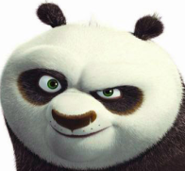

head
This is my .

Slide 12
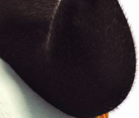
arm
This is my .

Slide 13

hand
This is my .

Slide 14
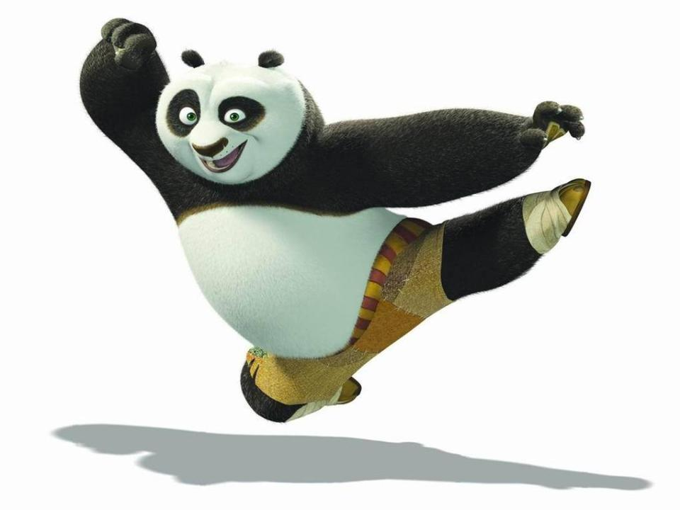
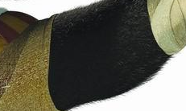
leg
This is my .

Slide 15

foot
This is my .

Slide 16






arm
leg
foot
head
hand

Slide 17
arm
leg
foot
head
hand

Slide 18
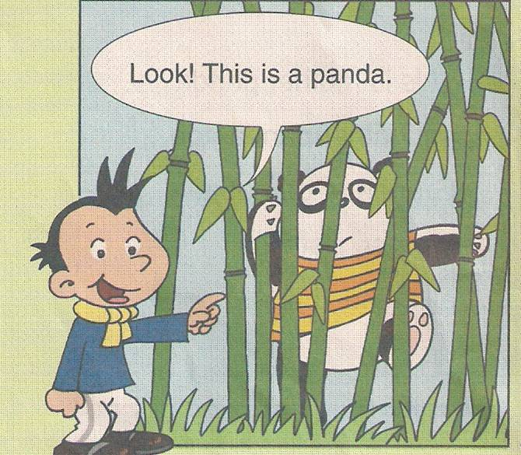

Slide 19
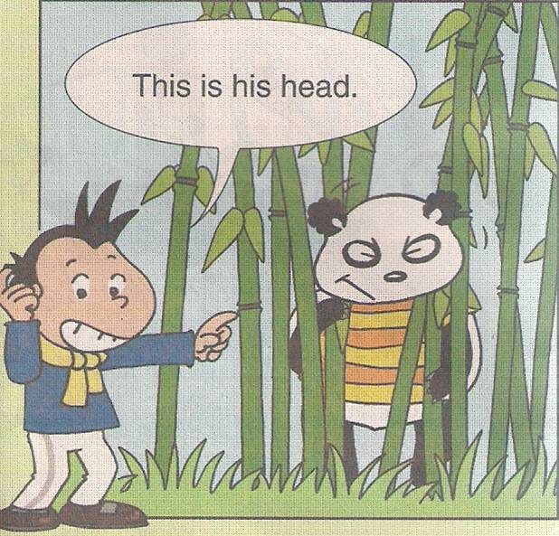

Slide 20
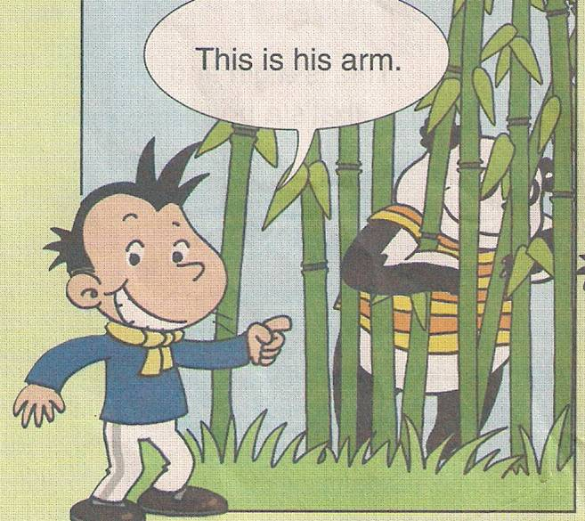

Slide 21
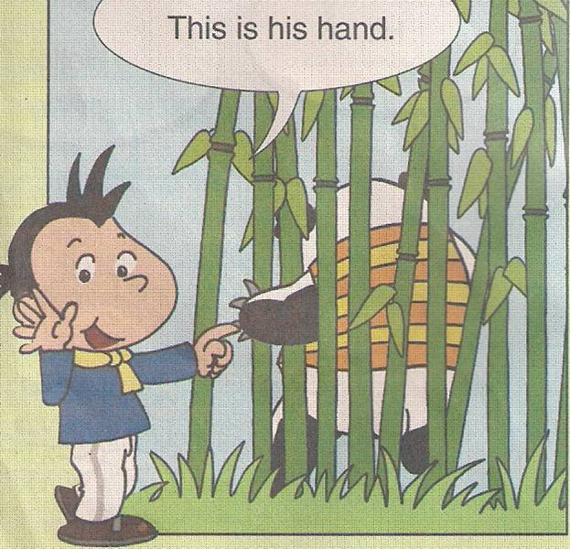

Slide 22
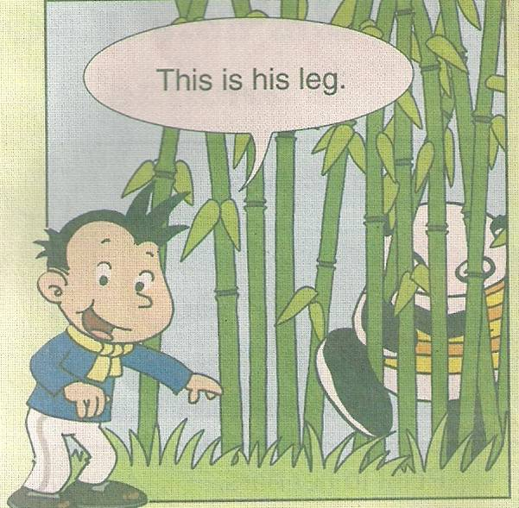

Slide 23
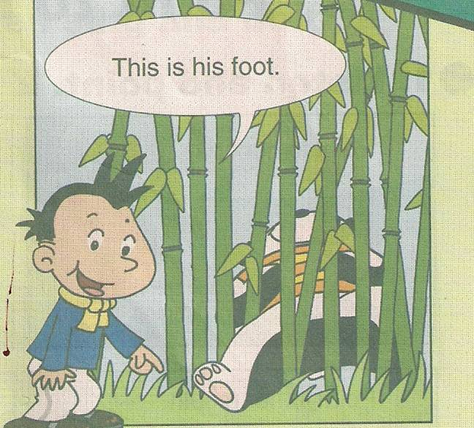

Slide 24


Slide 25
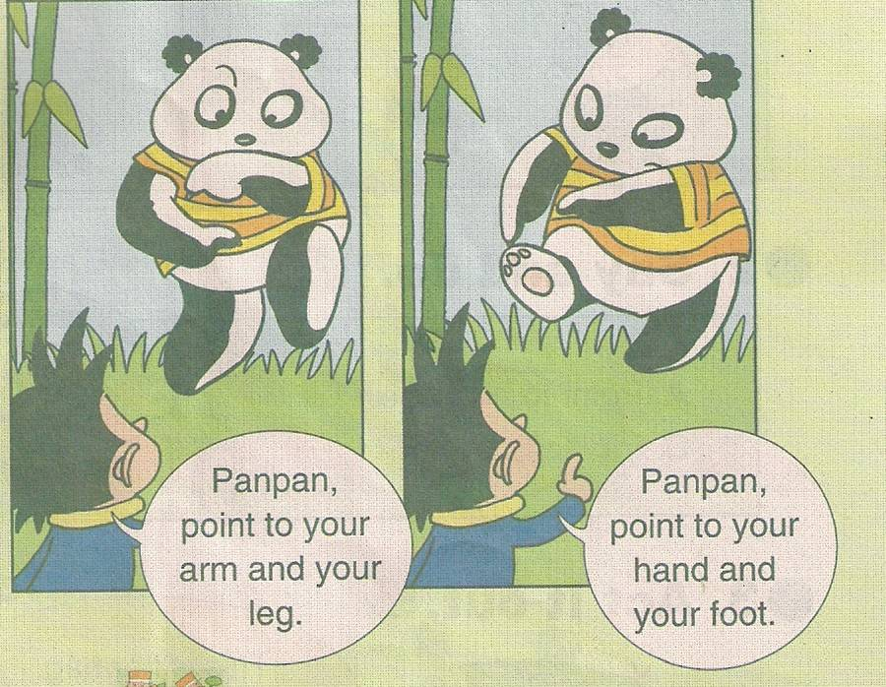

Slide 26
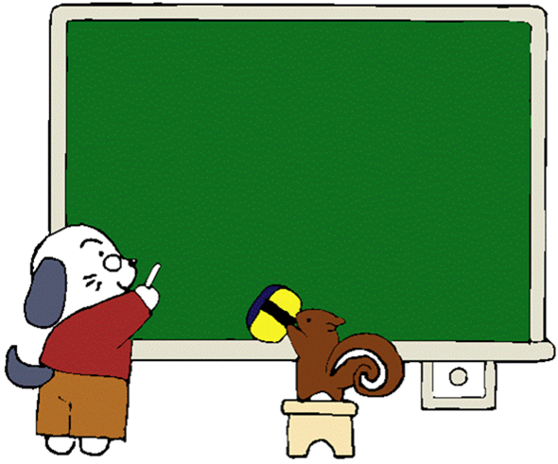
homework
1.将本课所学的单词抄写5遍。
2.能将所学的单词和身体的各个部分对应起来。

